Slide 1
Tracer: A GPS-Tracking / Map-Making App
Group 8: Matthew Cooper,
Griffin Snyder, Li Zha

Slide 2
Overview
latitude / longitude samples are taken from the phone’s GPS
samples are stored in CSV files
files are synchronized with a server (implemented in PHP)

Slide 3
Usage Walkthrough
Login
Server Synchronization
Home
Settings
Recording
Visualization
History

Slide 4
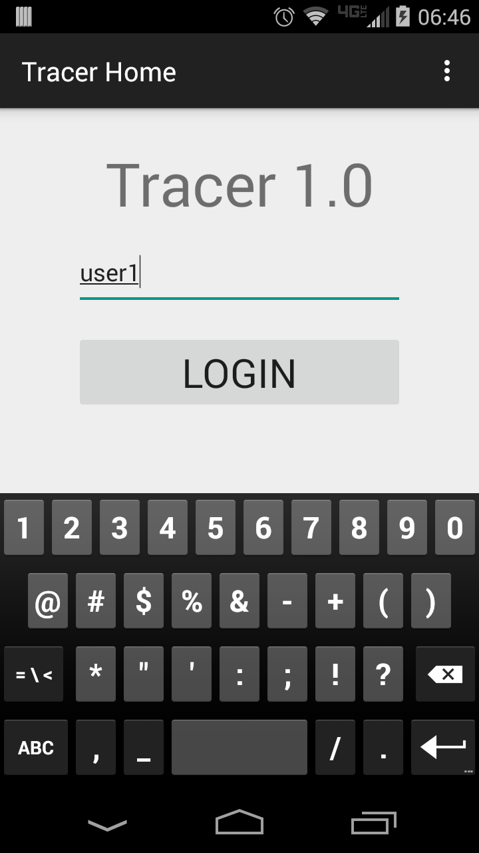
1/7: Login
Simple login: no registration, no password, no privacy
only used to delineate files stored on the server

Slide 5
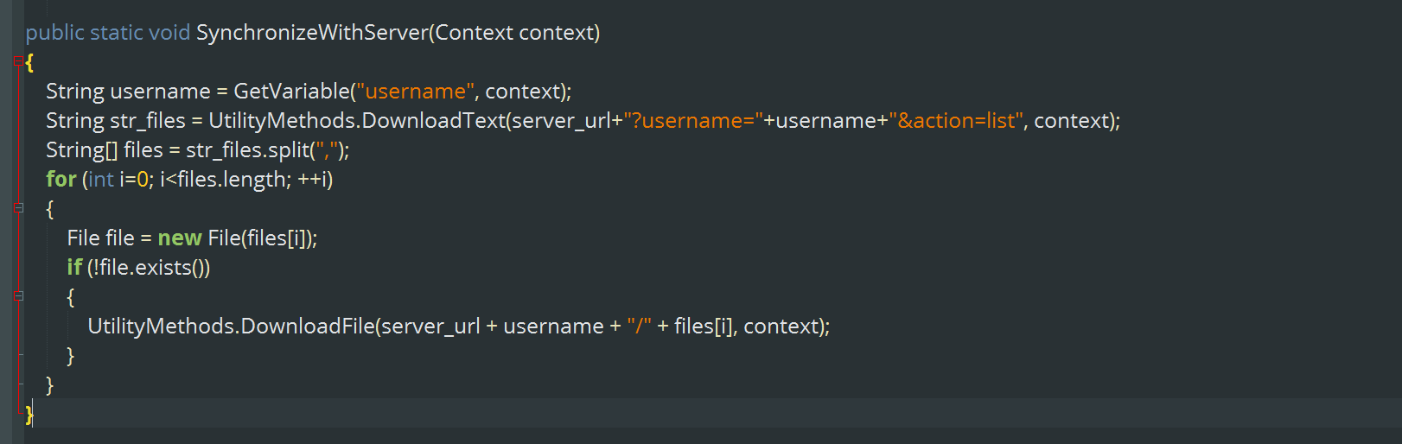
2/7: Server Synchronization
Once the user logs in, the app synchronizes all paths files on the server with local files

Slide 6
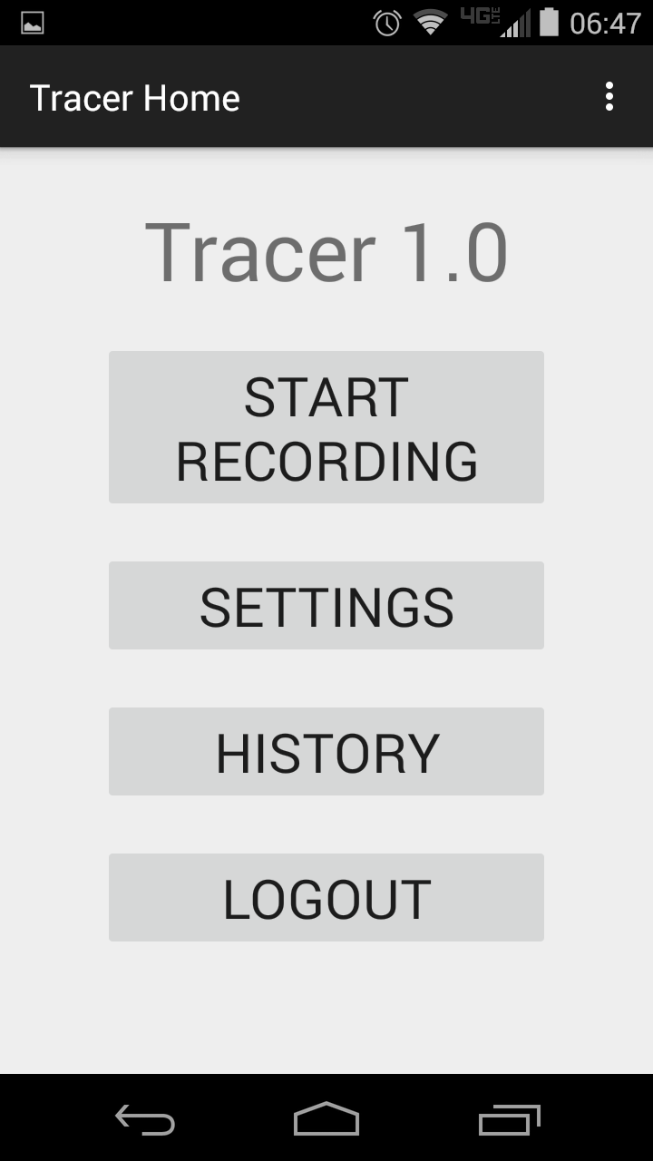
3/7 Home
Start Recording
Settings
History
Logout

Slide 7
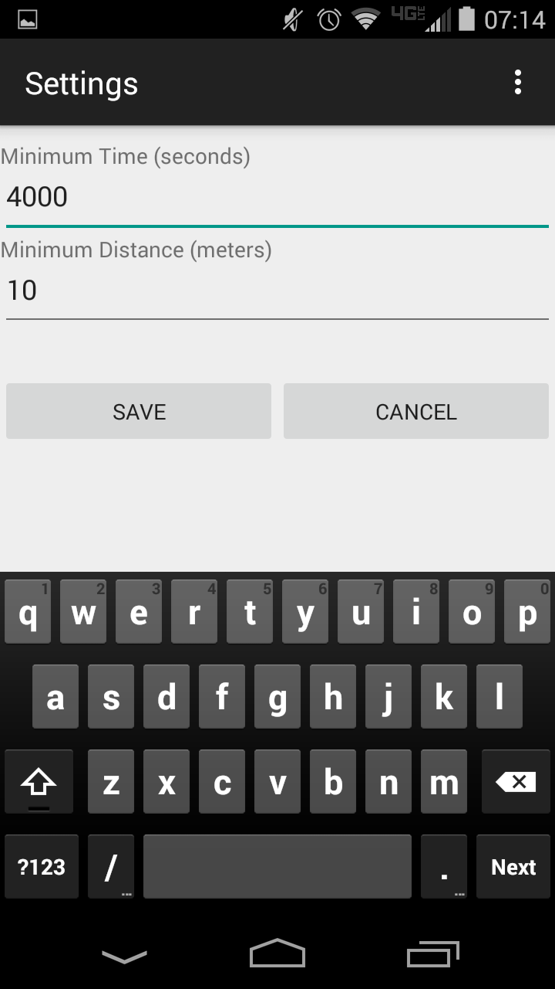
4/7: Settings
Minimum Time
Minimum Distance

Slide 8
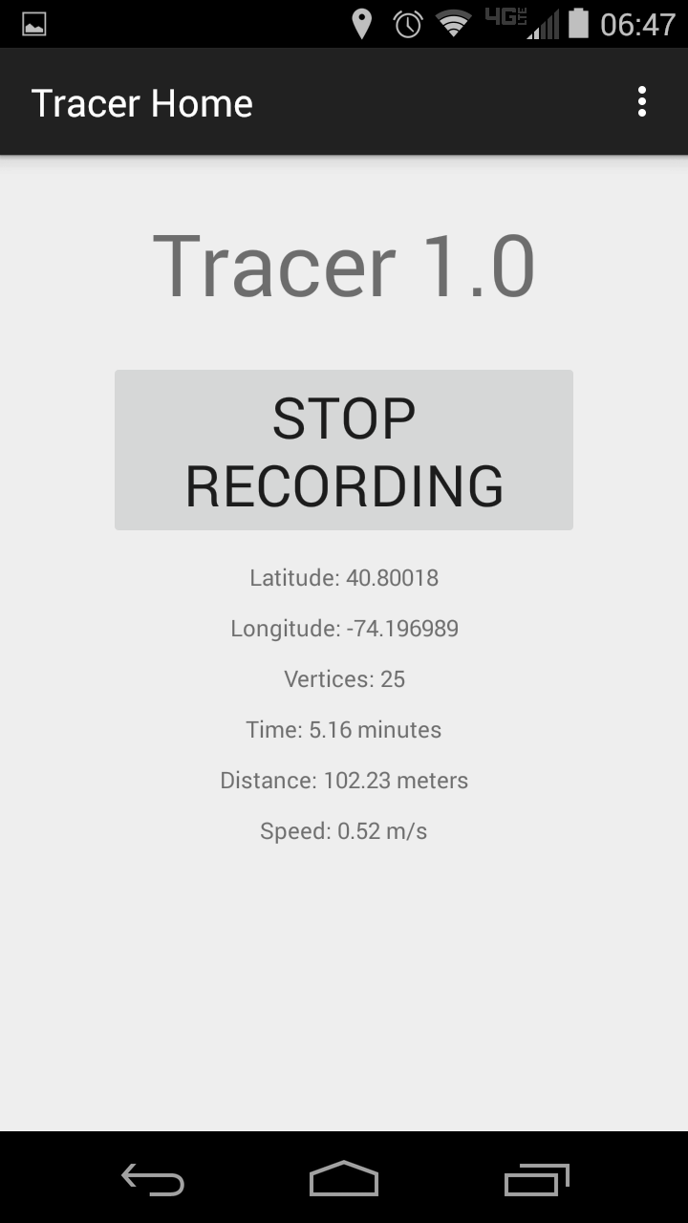
5/7: Recording
Latest Lat/Long
Number of Vertices
Time Passed
Distance Covered
Speed

Slide 9
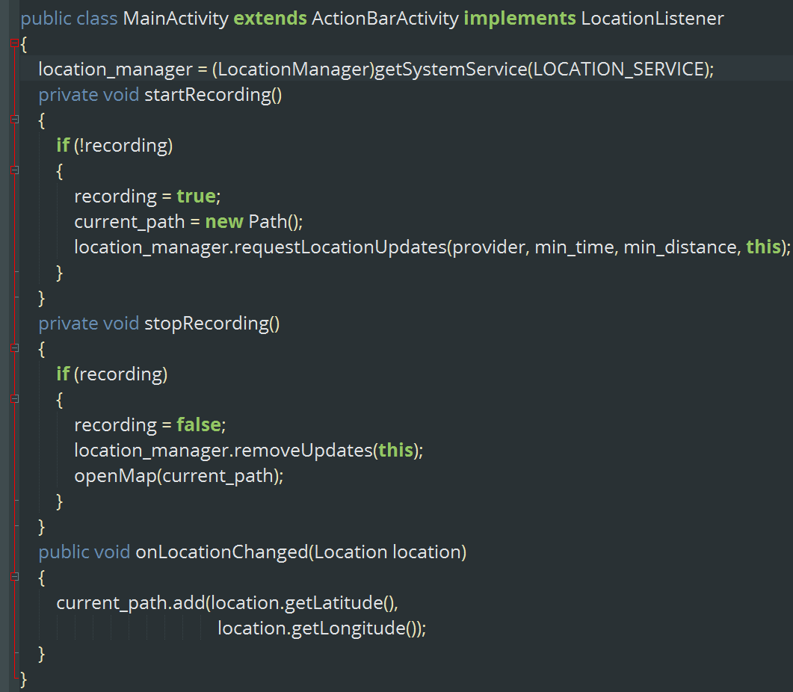
5/7: Recording
code

Slide 10
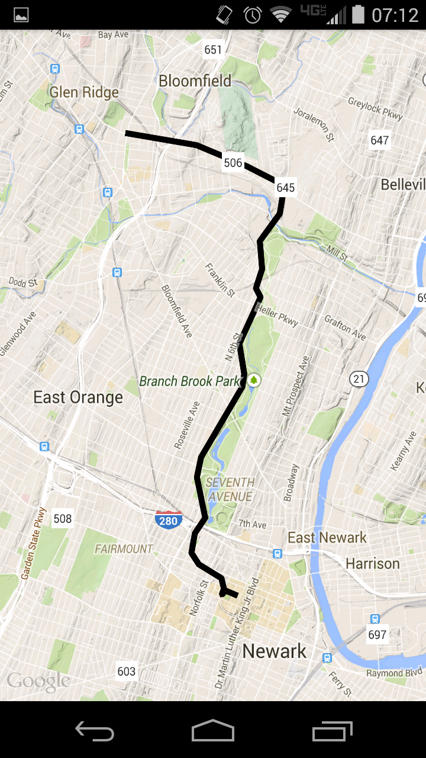
6/7: Visualization
superimpose path on google maps
able to pan / rotate

Slide 11
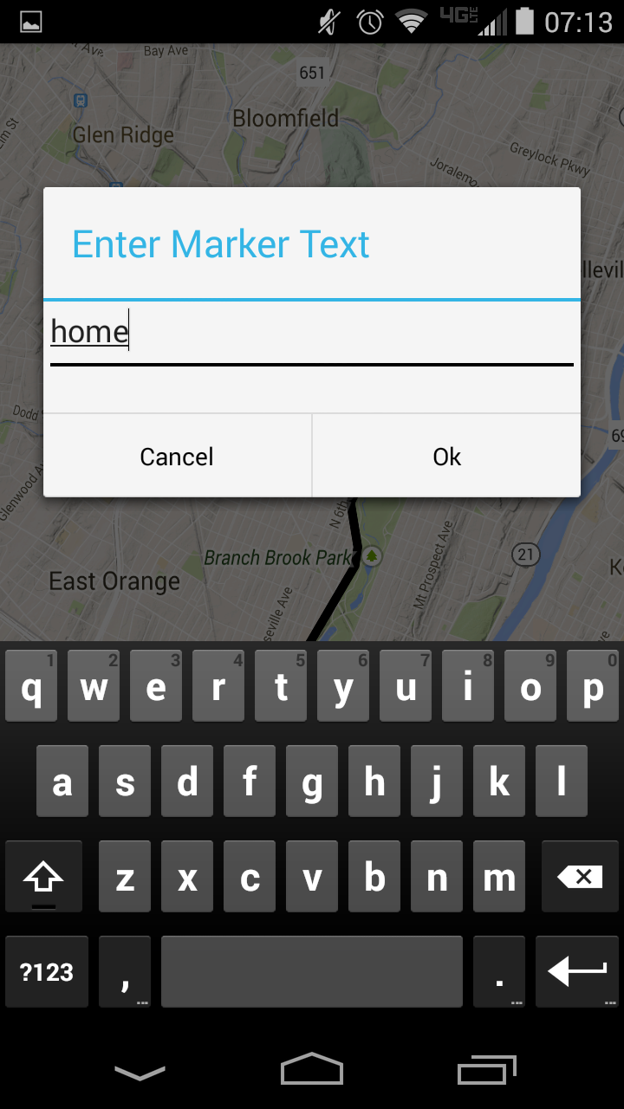
6/7: Visualization
tap anywhere to create a marker
enter text to name it
markers are saved with the path

Slide 12
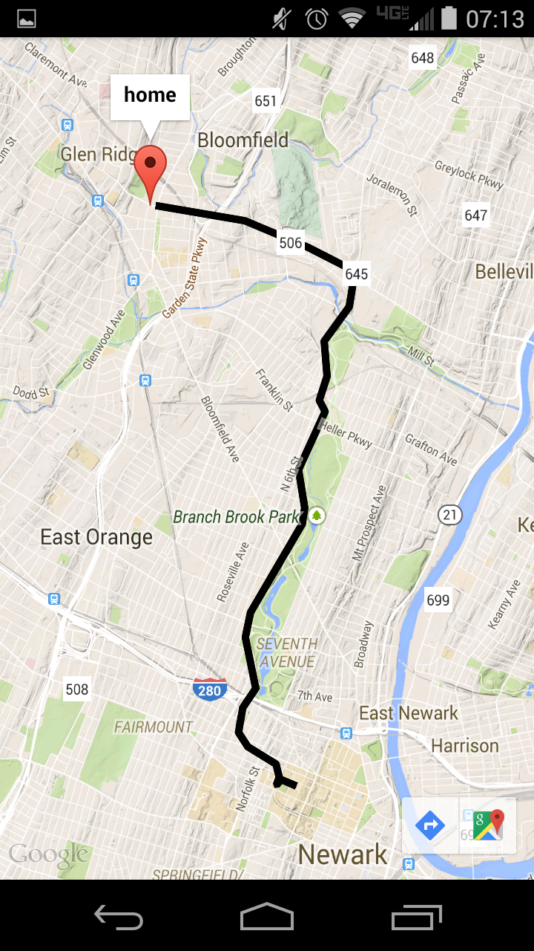
6/7: Visualization
tap anywhere to create a marker
enter text to name it
markers are saved with the path

Slide 13
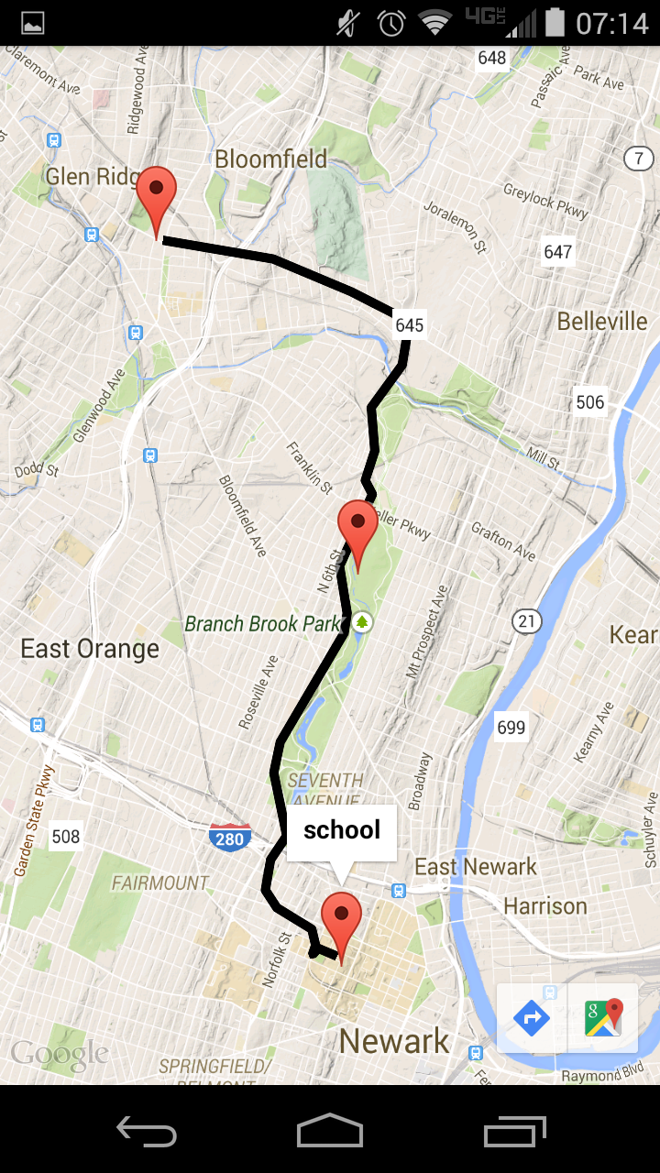
6/7: Visualization
tap anywhere to create a marker
enter text to name it
markers are saved with the path

Slide 14
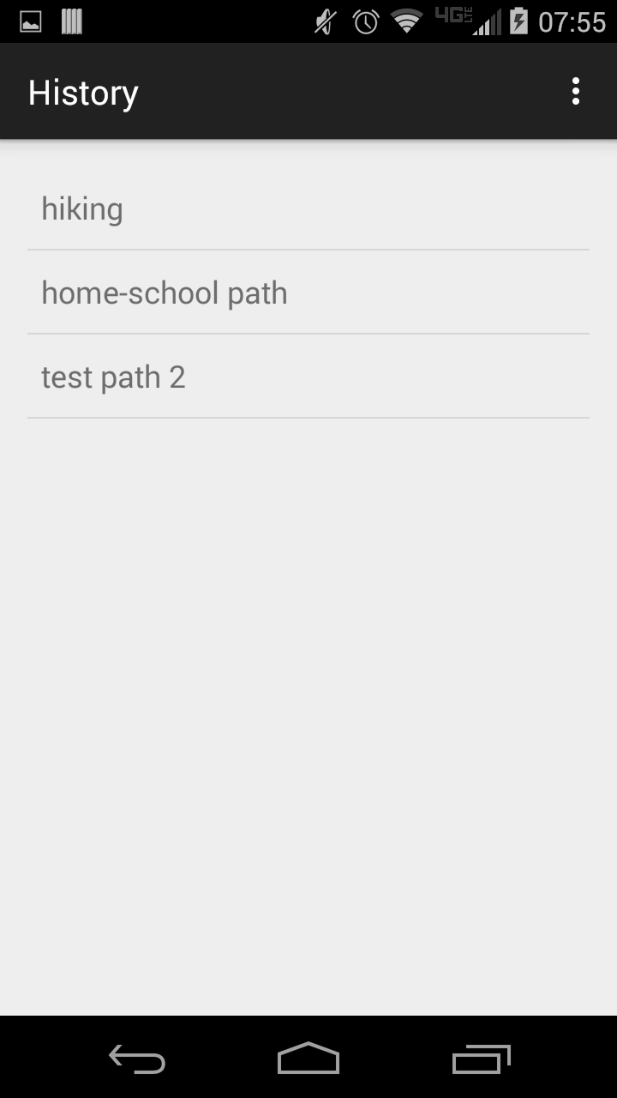
7/7: History
user can visualize and add markers to previously recorded paths

Slide 15
8/7? The Future!
Legitimate login system
Export to google maps URL
Social media integration
Web Interface
Photo integration

